Slide 1

Event-Driven Equipment Management System
A scalable solution for tracking and managing corporate assets using event-driven architecture

Slide 2

The Challenge We're Solving
Corporate offices rely on shared equipment like laptops, projectors, and tablets. Without a dedicated system, managing allocation, tracking usage, and ensuring timely returns becomes inefficient and error-prone.
Manual Tracking
No Follow-Up Mechanism
Allocation and returns are recorded manually, making it difficult to track who has what equipment and for how long.
Overdue returns, servicing needs, and damage reports often go unnoticed, leading to inventory gaps.
No Real-Time Visibility
Lack of Automation
Inventory status—available, in-use, or under maintenance—is not instantly accessible to stakeholders.
No automated reminders or team notifications during allocation, return, or maintenance workflows.

Slide 3
Business Requirements
A modern organization needs an efficient system to manage office equipment throughout its lifecycle—from issuance to return. The system must streamline coordination between employees, administrators, and IT support, ensuring accuracy, accountability, and real-time tracking of assets.
1
2
Equipment Allocation
Inventory Management
Assign equipment to employees with proper tracking, audit logs, and ownership visibility.
Maintain accurate records of available, allocated, and returned assets with live status updates.
3
4
Scalable Architecture
Automated Notifications
Built using Play Framework, Kafka, Akka, and MySQL to support real-time event processing and future expansion.
Real-time email alerts for allocations, returns, and overdue equipment.

Slide 4
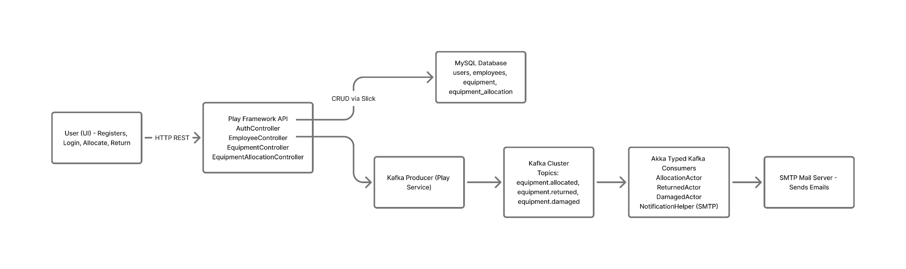
Architecture

Slide 5
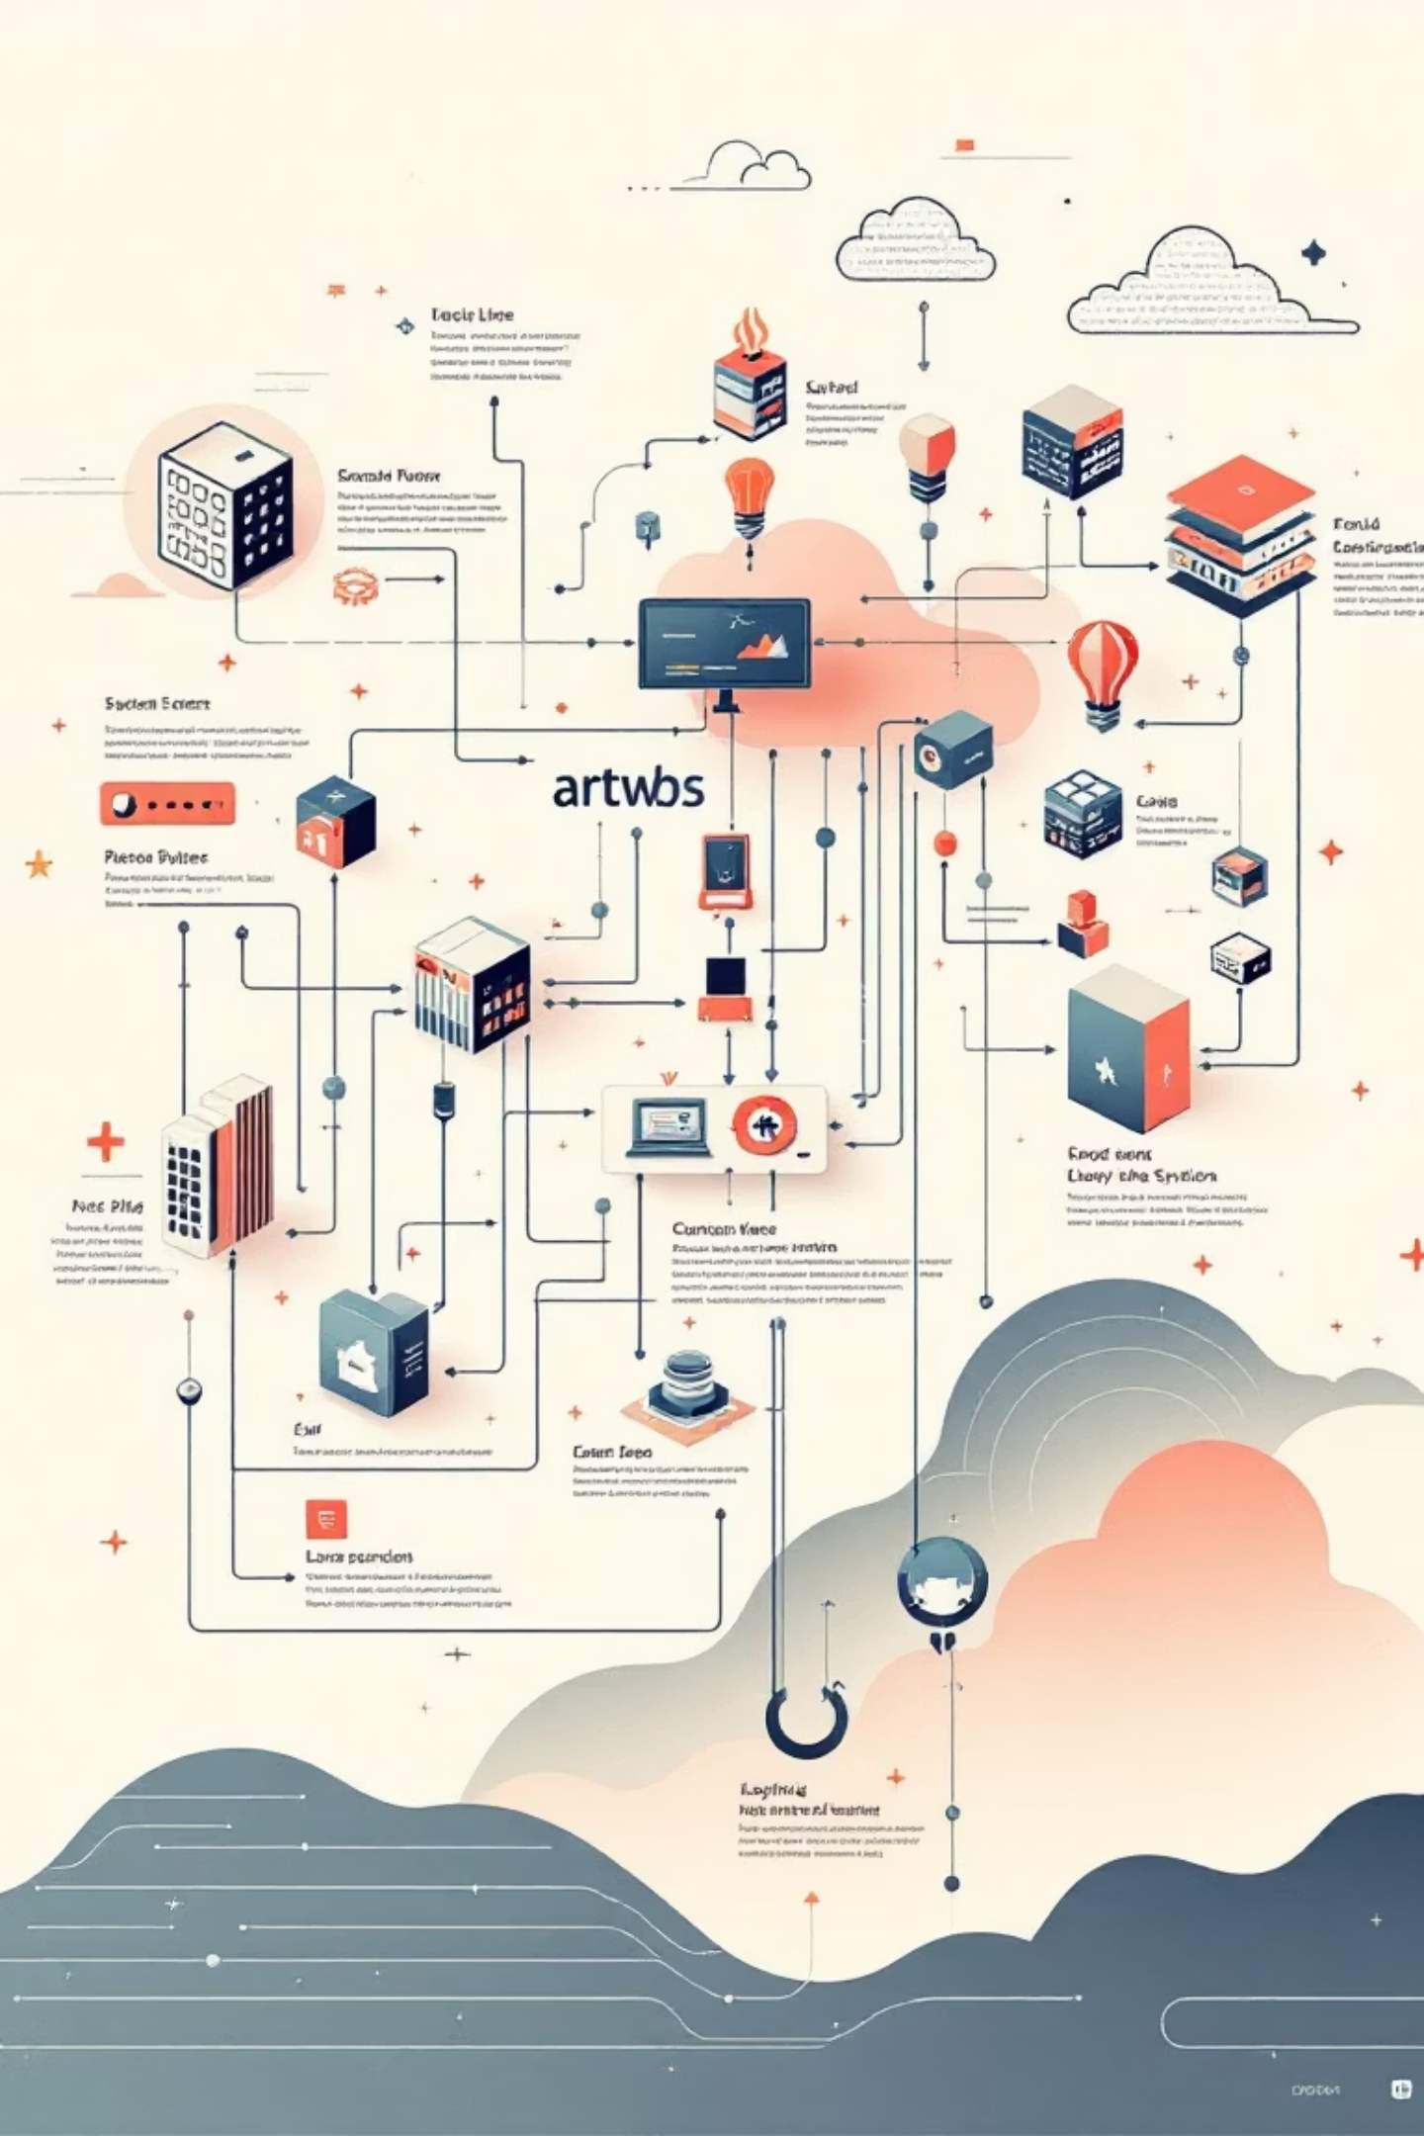
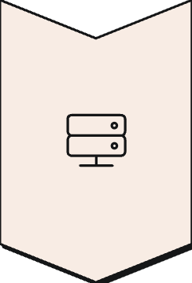



Event-Driven Solution Architecture
Play Framework Backend
REST APIs for equipment allocation and return. Updates MySQL records and equipment status, then publishes domain events to Kafka.
Akka Notification Service
Consumes Kafka events using actor-based processing. Sends overdue reminders, maintenance alerts, and allocation emails.
Kafka Event Bus
Enables asynchronous, decoupled communication. Ensures reliable and ordered event delivery across services.
Data Layer
Slick ORM for type-safe database access. Stores users, employees, equipment, and allocation history.

Slide 6
Implementation Flow Overview
01
02
Equipment Allocation Flow
Event Processing
User selects equipment and submits allocation request. The /allocate endpoint is invoked, controller validates user and equipment, allocation record stored in MySQL via Slick, and event published to equipment.allocated topic.
KafkaConsumer listens to new events, payload parsed and forwarded to AllocationCoordinatorActor. Actor routes event to appropriate Akka handler (Allocated / Returned / Damaged), then business rules are applied.
03
04
Notification & Automation
Equipment Return / Damage Flow
Handler triggers NotificationHelper, email sent via SMTP to employee, manager, or maintenance team. Optional REST callback to backend for audit logging or workflow continuation.
User initiates return via /return endpoint, DB updated with status and condition, event published, Akka actors process event, notifications and maintenance workflows executed, equipment status updated.

Slide 7
Equipment Allocation Process
This flow is triggered when an employee requests or receives a device from inventory.
Request Submission
1
User requests allocation via UI
2
Validation
Backend validates employee and equipment availability
Database Update
3
Allocation record stored in database
4
Event Publishing
Event published to Kafka (equipment.allocated)
Notification
5
Akka consumer sends allocation confirmation email
6
Status Update
Equipment status updated to Allocated

Slide 8

Equipment Return Process
This handles when an employee returns equipment back to the inventory system.
Return Initiation
User triggers return through UI with equipment details
Backend Processing
Backend updates DB with return status and equipment condition
Event Publication
Event published to Kafka (equipment.returned)
Consumer Processing
Akka consumer processes and sends return confirmation email
Status Resolution
Equipment status updated to Available or Damaged based on condition

Slide 9

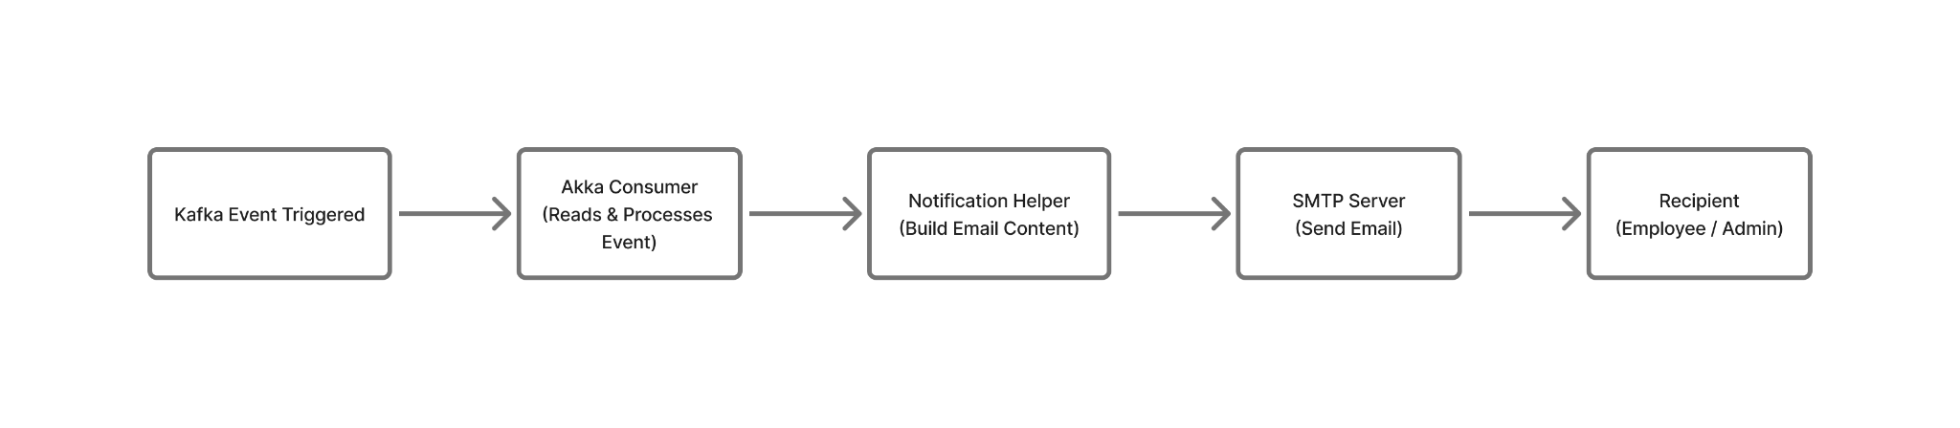
Notification & Communication Workflow
This supporting process runs in parallel to other flows via event handling, ensuring stakeholders stay informed throughout the equipment lifecycle.
Key Actions
Actors consume Kafka events in real-time
NotificationHelper builds and sends email alerts through SMTP
Supports allocation, return, and escalation communication
Ensures real-time messaging without blocking UI or backend operations

Slide 10
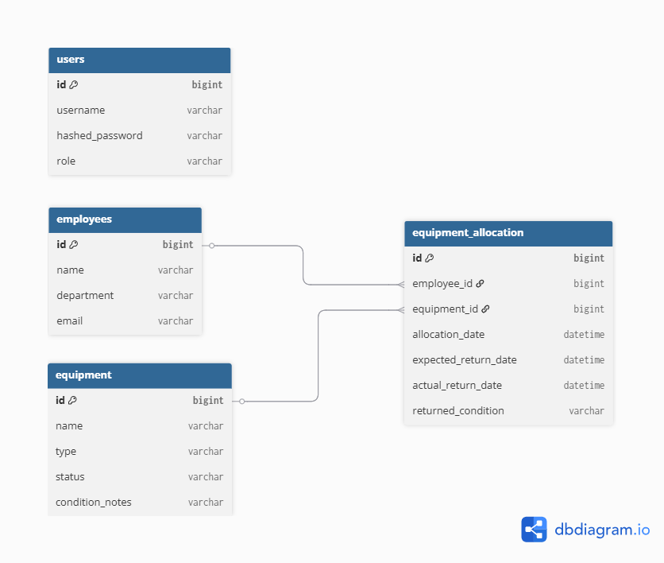
Entity Relationship Model
Core Entities
Relationships
Employees: Stores employee details and department association.
Employee → Equipment Allocation: One employee can have multiple allocation records over time.
Equipment: Represents assets with type, status, and condition tracking.
Equipment → Equipment Allocation: Equipment may be allocated multiple times throughout its lifecycle.
Users: Handles system authentication and role-based access control.
Equipment Allocation: Records assignment history including allocation and return details.
Users: Independent entity used for login and permissions, not directly tied to allocation data.

Slide 11

Thank You

